Slide 1

Phone Selling Software
Made by: Nguyen Le Minh Tan, Huynh An Nguyen
521H0150, 521H0467

Slide 2

Introduction
In today's digital age, smartphones have become an essential part of our lives. With the increasing demand for smartphones, there is a need for efficient and effective software that can help in the management and selling of these devices.
A phone selling software using WinForms is one such software that can help in the management and selling of smartphones. In this essay, we will introduce the concept of a phone selling software using WinForms and discuss the benefits that can be gained from this project.

Slide 3
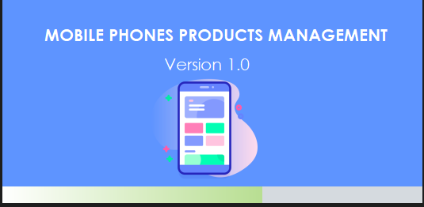
Our Splash Form
This form is for loading the application

Slide 4
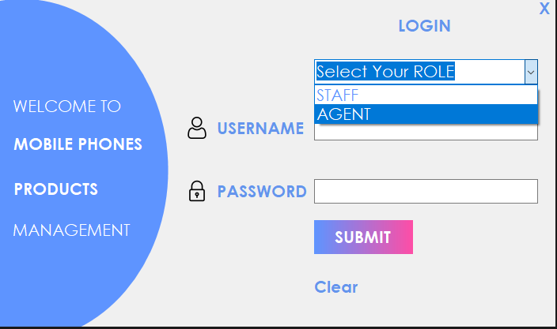
Our Login Form
There are two main roles:
The Staff(Admin) which is responsible for the products management
The Agent(Seller) which is responsible for placing orders and selling products to customers
- The submit button will lead to Selling Form or the Product Form depending on the role that the use chooses.
- The clear button will clear the text box of username and password.

Slide 5
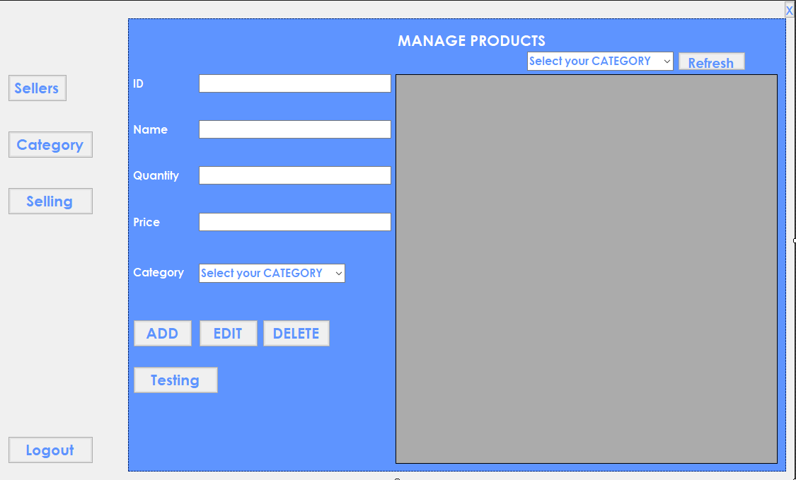
Product Form
The Product Form
This form will allow the user(admin, staff) to add, edit and delete products.
This form can also lead to other forms like Seller Form, Category Form and Selling Form.
It also has a logout button for the user to log out.
The refresh will show all the product after the user perform some actions.
The combobox above the data grid view will filter the product that has the same category as the one showing.

Slide 6
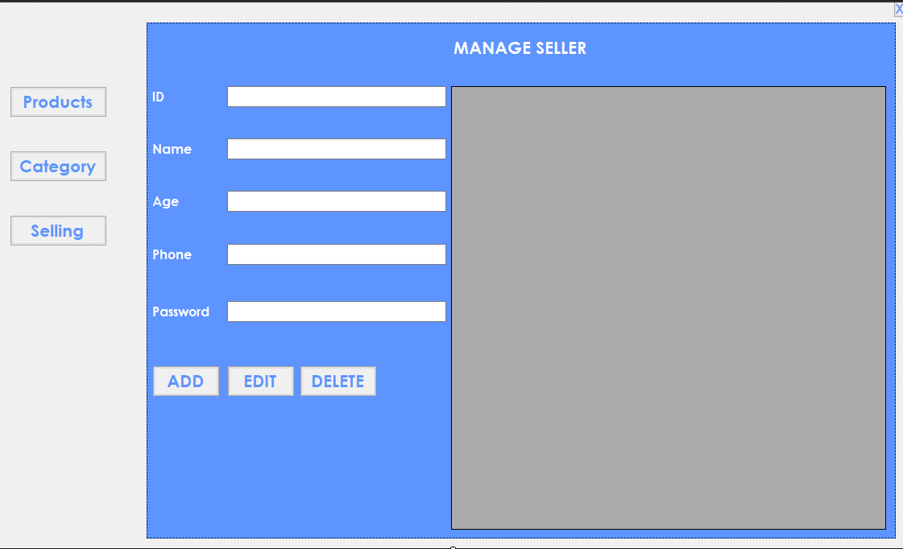
Seller Form
The Seller Form
This form will allow the user(admin, staff) to add, edit and delete sellers.
This form can also lead to other forms like Product Form, Category Form and Selling Form.
- The seller’s password and name will be used to log in to the selling form as username as password.

Slide 7
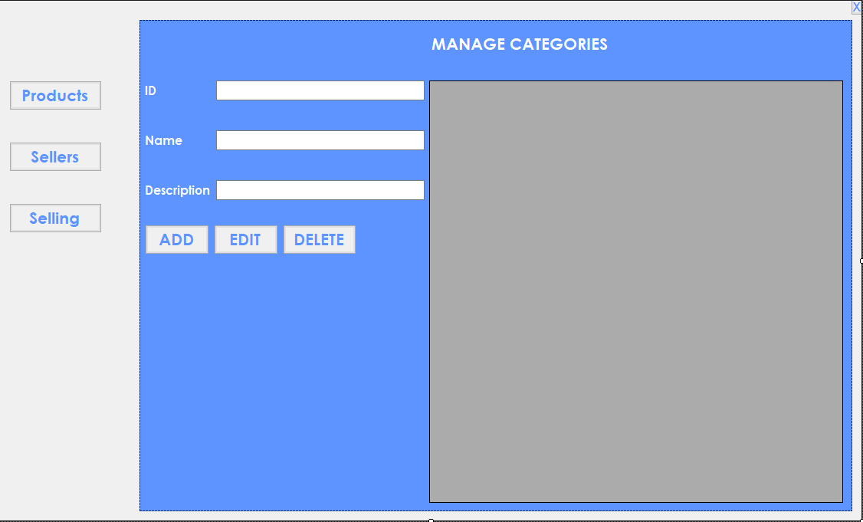
Category Form
The Category Form
This form will allow the user(admin, staff) to add, edit and delete categories.
This form can also lead to other forms like Product Form, Seller Form and Selling Form.
- The category name will be linked into the product’s category name.

Slide 8
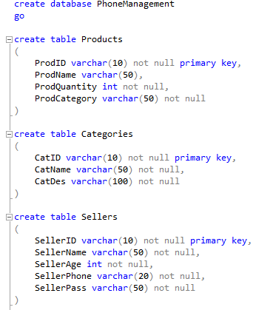
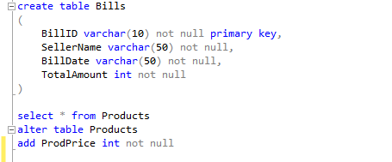
Database
Database
- We use Database which is written from MSSQL.

Slide 9

What we gain from our Project
Knowledge gained from the project
Overall, a phone selling software using WinForms is an essential tool for any business that sells smartphones and wants to improve their operations.
Knows how to work as a team to develop an application for businesses.
Knows how software works.
Acknowledging the fundamentals of building an application from scratch.
Knows how to access database and how to work with them via services.
It is a valuable tool for businesses that sell smartphones.
By using this software, businesses can increase efficiency, improve accuracy, provide a better customer experience, and generate better reports on their sales and inventory data.

Slide 10


T&N Co Thank You So Much For Listening To Us
Huynh An Nguyen
Nguyen Le Minh Tan

